Slide 1
Project Phase - 2
GROUP – 11 (A)
Guide : Dr. Jyothish Lal G
Co-Guide : Dr. Premjith B
1

Slide 2
TEAM MEMBERS
Mohitha Velagapudi
02
CB.EN.U4AIE21032
J.R.S. Ajay Surya
01
03
M. Prasanna Teja
CB.EN.U4AIE21018
CB.EN.U4AIE21035
M. Santhosh Kumar
05
04
P. Sai Ravula
CB.EN.U4AIE21131
CB.EN.U4AIE21041
2

Slide 3
Hate Speech Detection in Telugu: An Exploratory study on Modality
3

Slide 4
01
PROBLEM STATEMENT
4

Slide 5
“To conduct an explorative study on Hate Speech detection in Telugu social media data by collecting a comprehensive multi-modal dataset from YouTube, in accordance with its content guidelines, and performing an in-depth analysis of modality dependencies of hate speech across various categories.”
5

Slide 6
02
LITERATURE SURVEY
6

Slide 7
Id | Paper title | Methods Used | Dataset
1 | The robust feature extraction of audio signal by using VGGish model. | Used VGGish model for feature extraction and made comparative analysis with traditional feature extraction methods. | A comparative study
2 | Multimodal Amharic Hate Speech Detection Using Deep Learning | Multi-modal approach using MFCCs and Word2Vec & Deep learning algorithms such as LSTM, BILSTM, GRU, and BIGRU | YouTube video dataset
3 | DravLangGuard: A Multimodal Approach for Hate Speech Detection in Dravidian Social Media | Uni models: Speech – MFCC, mel -spectrogram, Chromogram; Text – BERT models. Multimodal: Combined speech and text features; fusion with SVM, RF, LR, NB | YouTube videos(text and speech)
4 | Multimodal Abusive Language Detection and Sentiment Analysis in Dravidian Language | Unimodal: Text – mBERT; Video – ViT; Speech – MFCCs. Fusion: Combined mBERT, ViT, and MFCC features. | Video (Speech, Text)
5 | Cross-lingual hate speech detection using domain-specific word embeddings. | A set of BERT models are used for word embeddings extraction and used multiple classifiers | English dataset, Italian dataset, Spanish dataset
7

Slide 8
03
Research Gaps & Objectives
8

Slide 9
Research Gaps
Objectives
Collected a diverse and rich Telugu dataset from YouTube. Annotated the dataset according to YouTube’s Hate speech policy.
Developed classification models that perform both binary and multi-class classification.
We will conduct a comprehensive exploratory study that focus on studying & exploring various aspects of Hate Speech detection task which includes the study on both text based and speech-based modalities.
Lack of rich annotated data for Telugu Hate Speech.
Limited research on the multi-class classification of Hate Speech, with most existing studies focusing on binary classification using only textual data
Very limited work that focuses on exploring modality dependency for the task of Hate Speech detection.
9

Slide 10
04
DATASET DESCRIPTION
10

Slide 11
A well-balanced dataset has been collected by us from YouTube, which is a widely used social media platform.
Dataset includes of 1hr of Hate Speech and 1hr of Non-Hate Speech samples. Transcripts of the same are also collected through manual transcription.
The samples from Hate Speech are organized into 4 classes corresponding to different categories of Hate Speech.
The above classes are considered based on the YouTube Hate speech Policy.
Gender
Religion
Political / National Affiliation
Personal Defamation
11

Slide 12
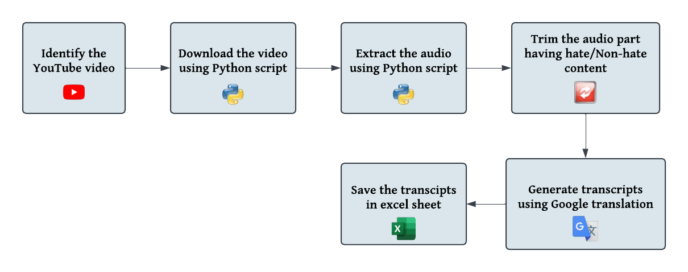
Procedure involved for Collecting the dataset –
12

Slide 13
Meta-data description
For AUDIO data:
 | HATE |  |  |  | NON-HATE
 | RELIGION | POLITICAL | GENDER | CHARACTER ASSASINATION
Number of unique Speakers | 36 | 22 | 56 | 46 | 72
Number of Utterances | 82 | 68 | 111 | 132 | 208
For TEXT data:
Unique words in Hate samples | 3903
Unique words in Non hate samples | 3772
Unique words for whole dataset | 6975
13

Slide 14
05
PROPOSED METHODOLOGY
14

Slide 15
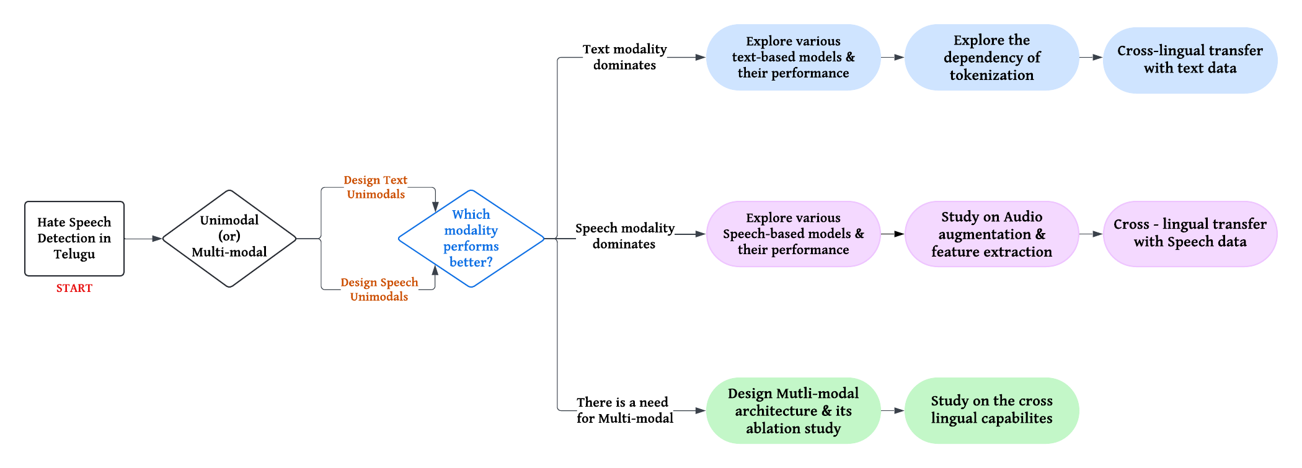
Flow Diagram
15

Slide 16
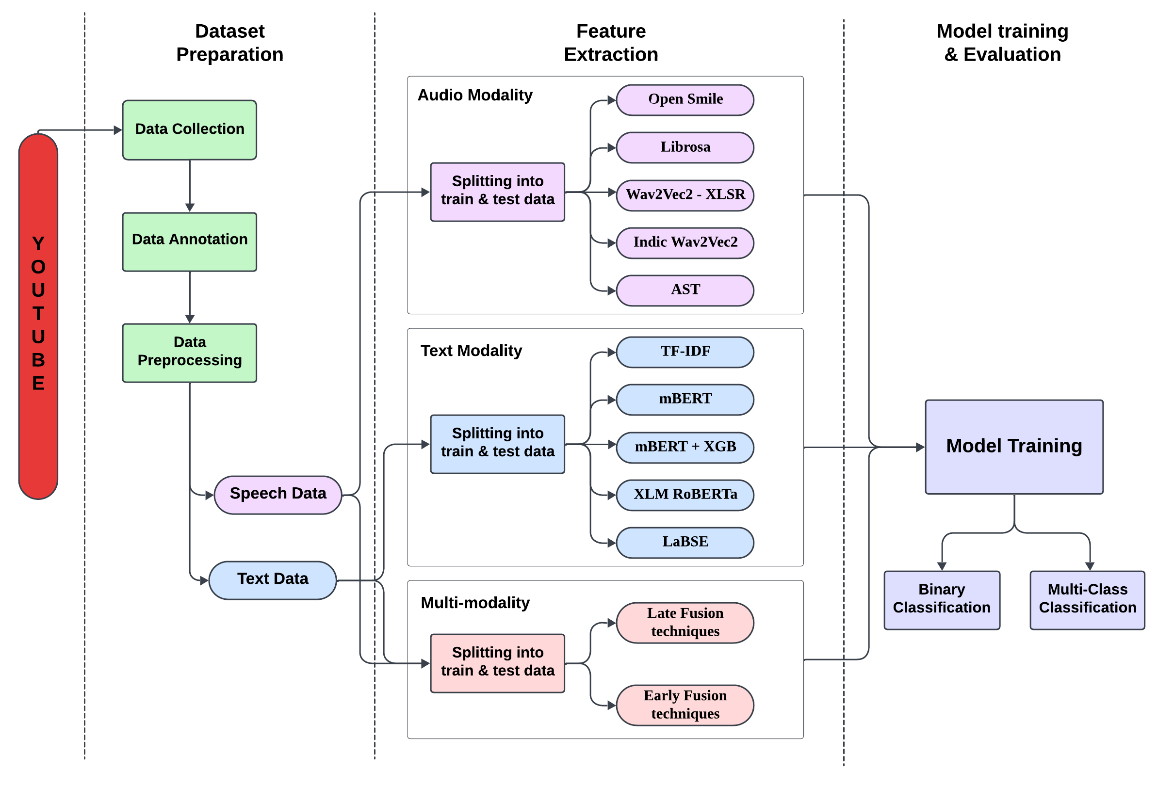
Proposed Pipeline
16

Slide 17
Why to study Modality dependency ?
Advantages of performing modality study –
Helps in finding out the contribution of each modality for the task of hate speech detection.
Helps in mitigating the limitations of single-modality models by considering both unique features from each modality.
Provides a base study for developing robust multi-modal approaches using fusion techniques.
Helps in guiding the future dataset expansion which involves identifying which data is needed the most, such as improved audio data for tonal analysis, etc.
Helps in deploying the pipelines across different domains that handle different data.
17

Slide 18
Summarizing….
Advantages of performing modality study –
Helps in finding out the contribution of each modality for the task of hate speech detection.
Helps in mitigating the limitations of single-modality models.
Provides a base study for developing robust multi-modal approaches using fusion techniques.
Helps in guiding the future dataset expansion which involves identifying which data is needed the most, such as improved audio data for tonal analysis, etc.
Helps in deploying the pipelines across different domains that handle different data.
18

Slide 19
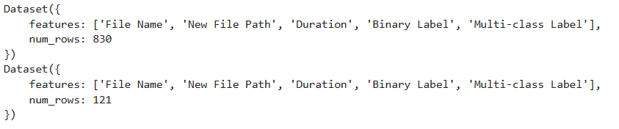
Data Preparation
The picture below depicts the structure of the training and testing set after splitting which is used to train the models.
Binary Label:
Hate : 1
Non-Hate : 0
Multi-class Label:
Character Assassination : 0
Gender : 1
Political : 2
Religion : 3
Non-Hate : 4
19

Slide 20
06
SPEECH UNI-MODELS
20

Slide 21
Speech Models
Following are the different models used for training the AUDIO dataset –
1) Open Smile features + SVM
2) Open Smile features + Gradient boost
3) Librosa Based Features
4) Wav2Vec2 – XLSR + LSTM
5) Wav2Vec2 – XLSR + CNN
6) Indic – Wav2Vec2
7) Audio Spectrogram Transformer (AST)
21

Slide 22
Speech Models
OpenSMILE is a feature extraction toolkit designed for speech and audio processing. It extracts handcrafted features such as MFCCs (Mel-Frequency Cepstral Coefficients), pitch, energy, spectral features, and prosodic attributes. These features are commonly used in emotion recognition, speech classification, and audio analysis tasks.
LIBROSA-based Features, we used the LIBROSA library to extract three types of features—mel-spectrograms (using 128 mel filter banks), MFCCs (40 coefficients), and chromagrams (12 chroma features)—to capture various aspects of the audio signal. To obtain a fixed-dimensional representation, we calculate the mean across the time axis for each feature type and then horizontally stack these mean vectors, effectively consolidating the spectral, cepstral, and harmonic information for subsequent analysis.
Wav2Vec2-XLSR is a self-supervised learning model designed for speech recognition. It learns representations directly from raw waveforms using a CNN-based feature extractor and a Transformer encoder. XLSR is multilingual, allowing it to generalize across different languages, making it useful for low-resource languages like Telugu.
Indic-Wav2Vec2 is a fine-tuned version of Wav2Vec2 optimized for Indian languages. Unlike the general XLSR model, this version is trained on speech datasets from Indic languages, capturing language-specific phonetic and acoustic features more effectively. This makes it a better choice for Telugu speech processing compared to standard Wav2Vec2.
Audio Spectrogram Transformer (AST) is a Transformer-based model designed for audio classification tasks. Instead of working directly on waveforms, it converts audio into spectrograms and processes them using a Vision Transformer (ViT). The self-attention mechanism helps AST capture both short-term and long-range dependencies in audio, making it highly effective for tasks like hate speech detection.
22

Slide 23
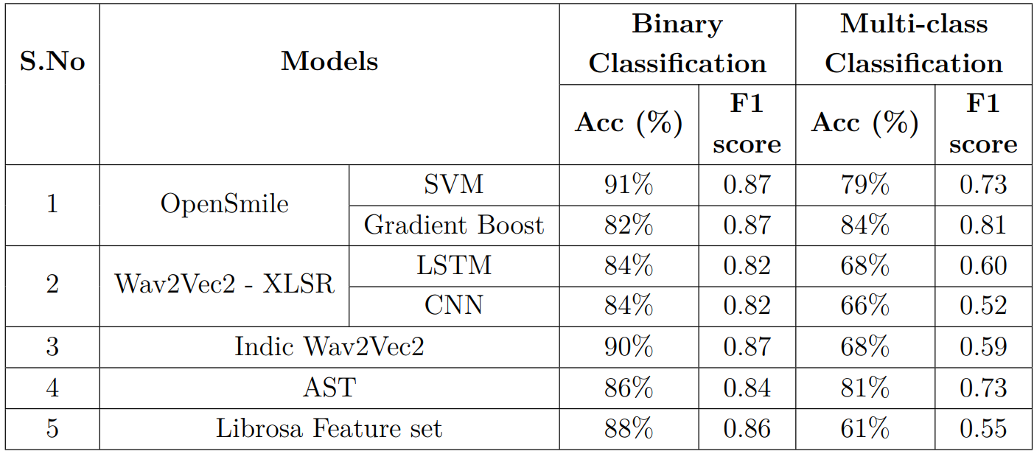
Results Summary of Speech Modality
23

Slide 24
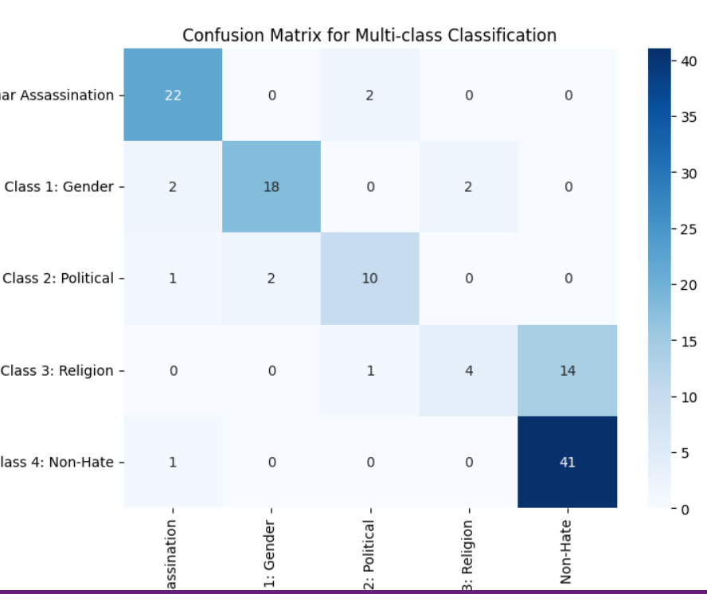
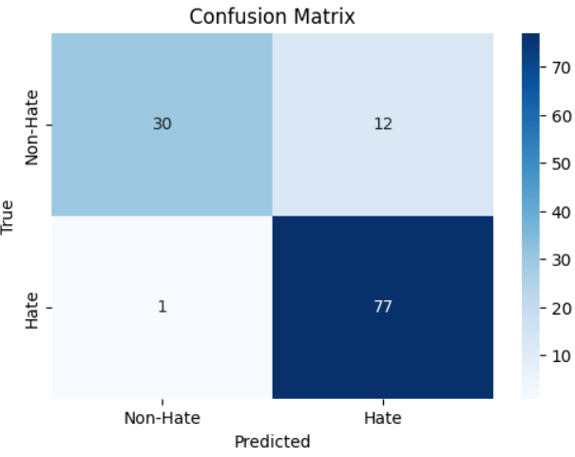
OPEN SMILE CF
24

Slide 25
Inferences
Upon observing the results, it is found that traditional handcrafted features are performing better in detecting Hate content.
Open Smile with SVM achieved the best accuracy of 91% (F1 score = 0.87) in binary classification and at the same time, Librosa feature set achieved 90% (F1 score = 0.86) accuracy in binary classification.
In the context of multi-class classification, Open Smile with GB gave 84% accuracy (F1 score = 0.81) which is highest among all.
AST gave a balanced result in both binary classification of accuracy 86% (F1 score = 0.84) and multi-class classification of accuracy 81% (F1 score = 0.73).
25

Slide 26
07
TEXT MODALITES
26

Slide 27
Text Models
Following are the different models used for training the Text dataset
1) Multi-Lingual BERT
2) Mbert + XGBoost
3) XLM - Roberta
4) TF-IDF + SVM
5) TF-IDF + Random Forest
6) LaBSE
27

Slide 28
Text Models
TF-IDF is a statistical measure used for text feature extraction. It evaluates how important a word is within a document relative to a collection (corpus). It helps capture word relevance rather than just frequency, making it useful for text-based hate speech detection. However, it doesn't capture semantic meanings or contextual relationships between words.
mBERT is a multilingual version of BERT (Bidirectional Encoder Representations from Transformers) trained on over 100 languages, including Telugu. It uses self-attention and contextual embeddings to capture deep semantic meanings across different languages, making it effective for cross-lingual NLP tasks, such as text classification and hate speech detection.
XLM-RoBERTa is an improved multilingual version of RoBERTa, optimized for cross-lingual understanding. Unlike mBERT, it is trained on larger datasets with a more refined masked language modeling objective, making it more effective for low-resource languages. It captures complex linguistic structures across different languages, making it a strong candidate for multilingual hate speech detection.
LaBSE which stands for Language-Agnostic BERT Sentence Embedding is a multilingual transformer model developed by Google, designed for cross-lingual sentence embeddings. It can represent sentences from different languages in a shared vector space, making it useful for tasks like text classification, machine translation, and cross-lingual retrieval.
28

Slide 29
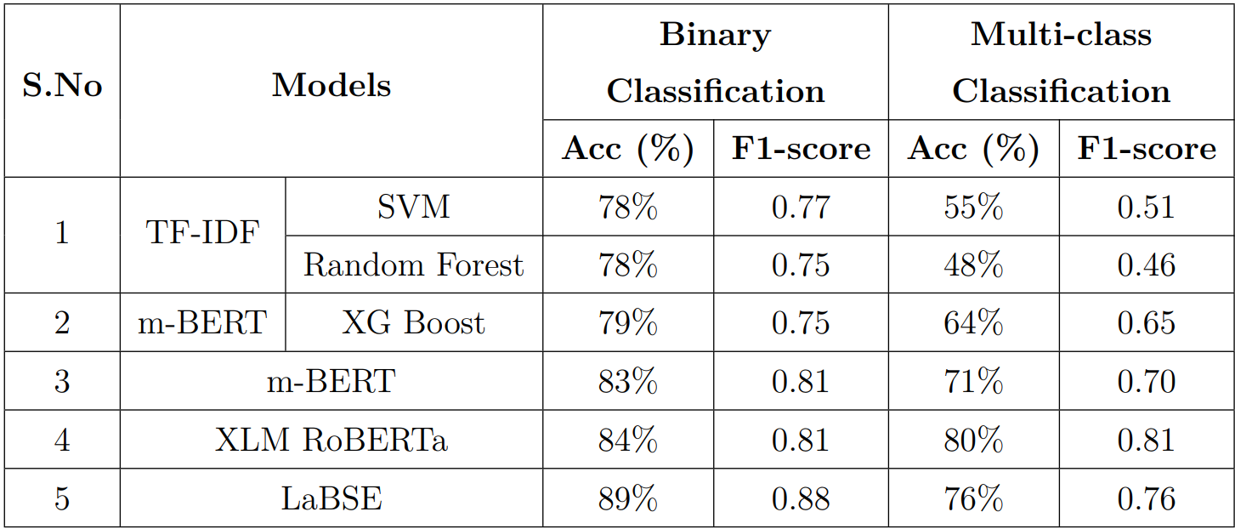
Results Summary of Text Modality
29

Slide 30
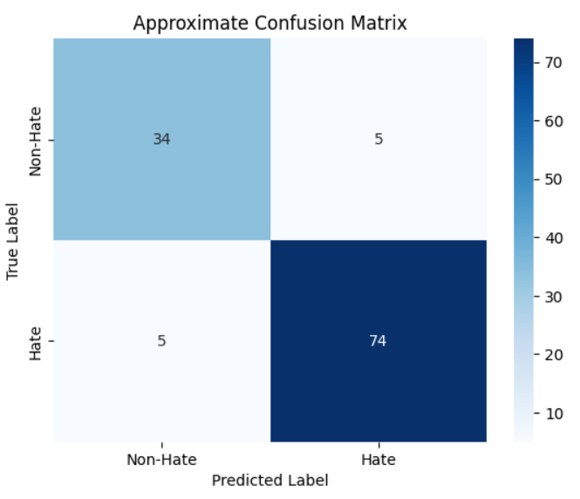
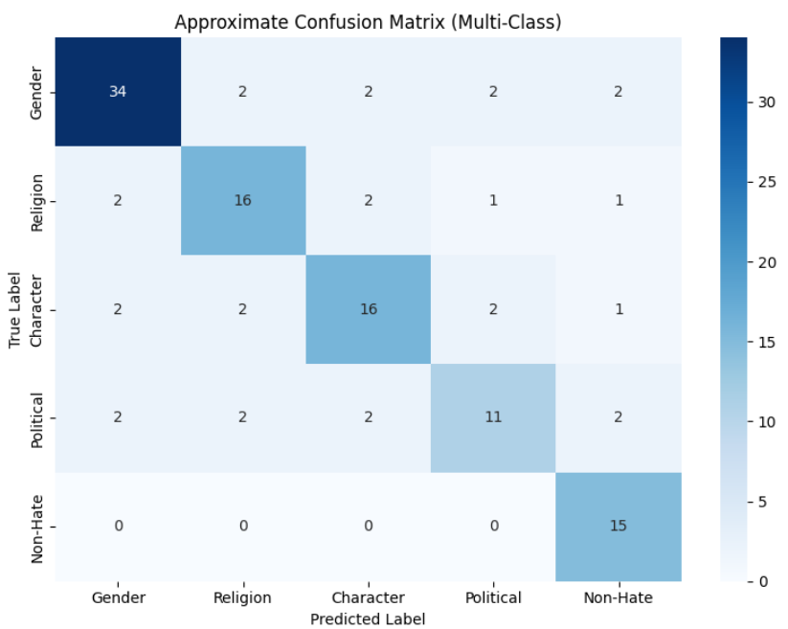
LaBSE CF
30

Slide 31
Inferences
In the context of text modality, BERT models performed better than the traditional models.
In particular, we find that apart from the TF-IDF methods, m-BERT combined with XG Boost yields better performance compared to the baseline.
A fine-tuned end-to-end model of m-BERT achieves an accuracy of 83% and an F1-score of 0.81 in binary classification.
The multi class performance was further improved with XLM-RoBERTa, achieving 80% accuracy and F1-score of 0.81.
This is noteworthy as LaBSE achieved the highest accuracy of 89% and the highest F1 score of 0.88 on binary classification problems and good multi class accuracy of 76%.
31

Slide 32
Results Summary of Uni Models
Speech Modality
Text Modality
32

Slide 33
08
MULTI - MODAL ARCHITECTURES
33

Slide 34
Explore Multi-modal Architectures
Since the Uni-modals are not giving satisfactory results, it is recommended to develop multi-modal architecture for comparing their performance.
In Multi-modal architectures, we combine information from multiple modalities (speech & text) to create a unified representation that can be used for classification.
There are three strategies followed in developing multi-modal architectures – Early Fusion, Late fusion and Intermediate Fusion.
The goal of fusing is to exploit the complementary strengths of each modality and enable the model to make more informed decisions.
In this exploratory study, we will explore different models following the above-mentioned strategies to assess their performance for the task of Hate Speech Detection.
34

Slide 35
Multi-modal Architectures
Early Fusion (Feature level):
It is a fusion strategy where features from multiple modalities (speech & text) are combined early in the processing pipeline, typically at the feature extraction stage.
Individual features will be extracted independently for each modality, then concatenated into a single unified representation either through pooling or transformations.
This unified representation will be then fed into a single model which will do the classification task.
All potential interactions between features from different modalities can be captured, allowing for deeper integration of complementary information.
One of the disadvantage of this technique arises when combining large feature vectors from multiple modalities that will result in high-dimensional inputs, increasing computational cost.
35

Slide 36
Early Fusion Architectures
To explore the performance of these strategies, we are going to consider the features from uni-modals we trained before and use them to build the multi-modal architectures.
We will be checking the performance of each and every combination between text modality and speech modality by developing their respective fusion models.
So, following are the different models developed using Early –
1) Wav2Vec2 with XLM-RoBERTa
2) OpenSmile with LaBSE
3) CLAP ( Contrastive Language - Audio Pretraining)
36

Slide 37
Early Fusion Architectures
For this fusion strategy, we developed models that integrates audio and text features using Cross-Attention:
Feature Projection:
Audio and text embeddings are projected to a common latent space (hidden_dim=512).
Cross-Attention Mechanism:
Audio and text embeddings interact using a multi-head attention mechanism.
This enables modality-aware feature refinement before classification.
Classification:
The fused representation is passed through a fully connected classifier for binary classification (Hate or Non-Hate).
37

Slide 38
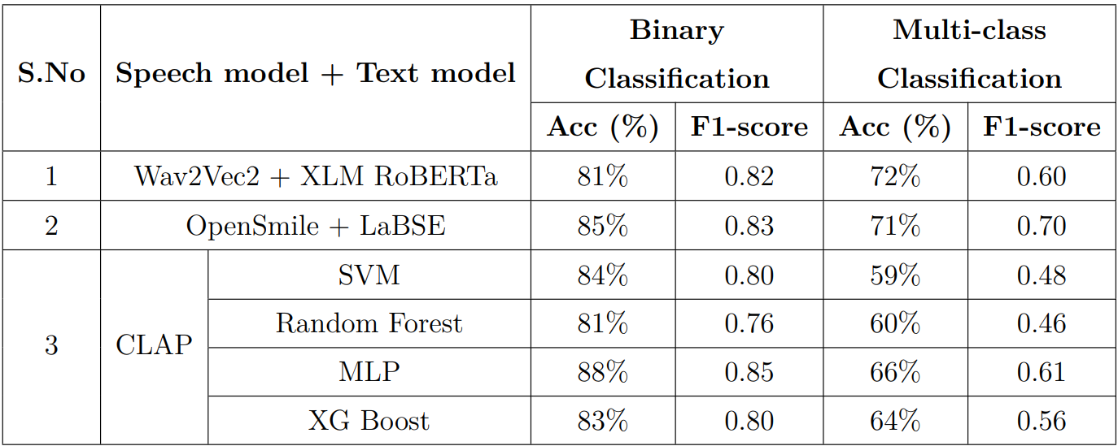
Results of Early Fusion Multi Modals
38

Slide 39
Multi-modal Architectures
Late Fusion (Decision level):
It is also a fusion strategy, where the outputs from each modality-specific models are combined at a later stage, typically at the output layer, to produce the result.
After training each model, we can employ techniques like weighted averaging / majority voting / concatenation + classifier to give a final decision.
This technique provides modularity where, Each modality-specific model can be trained and optimized independently in case of re-training.
One of the advantage of this model is its Robustness to Missing Data which will help the model to make decisions using remaining modality.
One of the downside of this technique is that, since modalities are processed independently, interactions between modalities are not learned directly during training.
39

Slide 40
Late Fusion Architectures
Following are the different models used for developing multi-modal architectures using Late Fusion –
1) Wav2Vec2 with XLM-RoBERTa
2) Open Smile with LaBSE
40

Slide 41
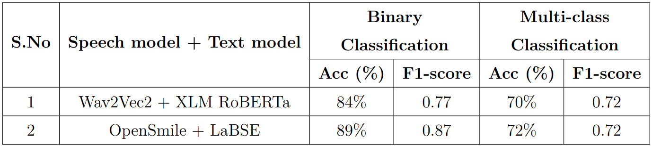
Results of Late Fusion Multi Modals
41

Slide 42
Inferences
The results demonstrate that performance improves through integrating audio and text features particularly when using the Open Smile and LaBSE combination.
Late fusion strategy with Opensmile + LaBSE outperformed other models in both Binary and Multi class classification achieving the accuracy of 89%(f1-score : 0.87) and 72%(f1-score : 0.72) respectively.
Also CLAP model on the other hand gave balanced results. Since it is specifically designed for Mult-model architecture.
42

Slide 43
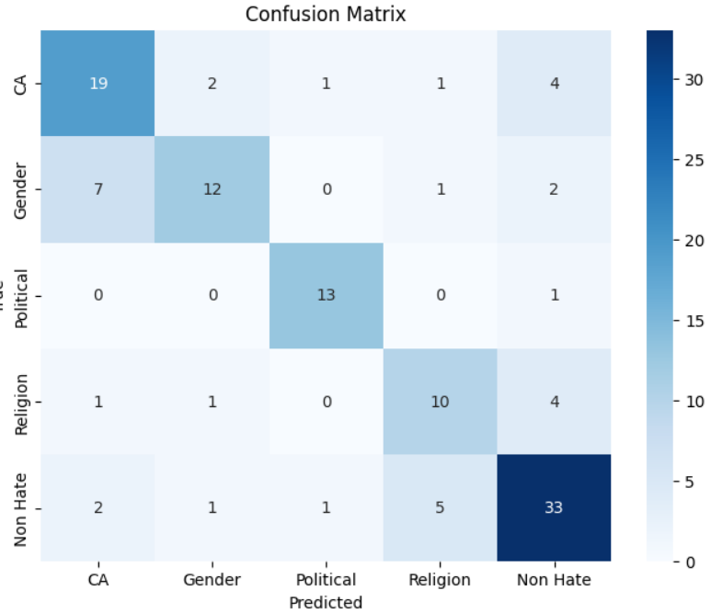
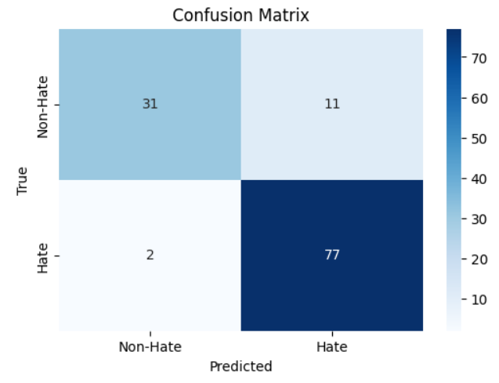
Open Smile + LaBSE CF
43

Slide 44
Results Summary of Multi Models
Early Fusion
Late Fusion
44

Slide 45
9
Ablation Study
45

Slide 46
Cross-lingual fine-tuning is crucial for low-resource languages lacking large annotated datasets.
The study investigates hate speech detection in Tamil using models originally trained on Telugu, both Dravidian languages.
The goal is to analyze generalizability of uni-modal and multi-modal systems across related but distinct languages without heavy reengineering or augmentation.
The study evaluates how Telugu-based speech models perform on Tamil data, providing insights into strengths and limitations in interlingual transfer.
46

Slide 47
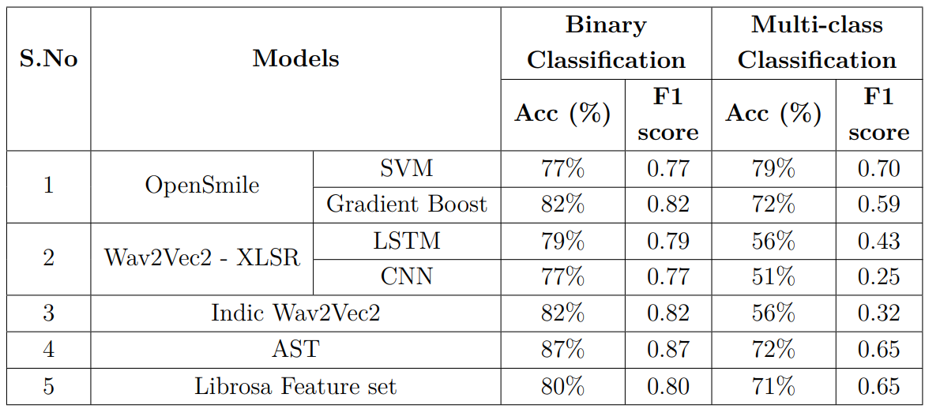
Results of Speech Modality on Tamil Data
47

Slide 48

Results of Text Modality on Tamil Data
48

Slide 49
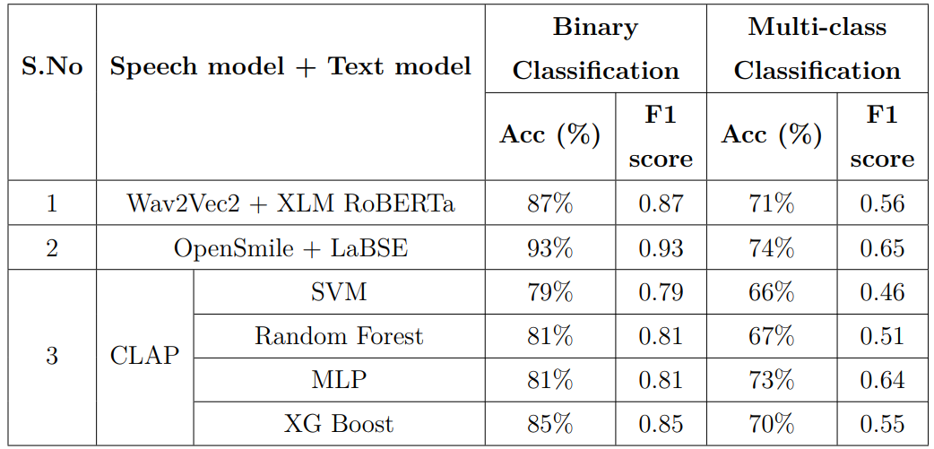

Results Summary of Multi Models on Tamil data
Early Fusion
Late Fusion
49

Slide 50
CONCLUSION
10
50

Slide 51
Conclusion
To conclude, our study, which involved the creation of a multi-modal dataset, laid the groundwork for exploring the relatively untapped area of hate speech detection in the Telugu language.
The results indicate that the speech modality is particularly effective for identifying hate content in Telugu.
Furthermore, insights from the ablation study highlight that maintaining a balanced dataset significantly enhances performance in multi-class classification tasks.
51

Slide 52
REFERENCES
11
52

Slide 53
References
Diwakar, Mandar & Gupta, Brijendra. (2023). The robust feature extraction of audio signal by using VGGish model. 10.21203/rs.3.rs-3036958/v1.
Gebremedin, Abreham & Woldeyohannis, Michael. (2022). Multimodal Amharic Hate Speech Detection Using Deep Learning. 102-107. 10.1109/ICT4DA56482.2022.9971436.
hate-alert@DravidianLangTech: Multimodal Abusive Language Detection and Sentiment Analysis in Dravidian Languages (Barman & Das, DravidianLangTech-WS 2023)
Monnar AA, Perez Rojas J, Labra BP. Cross-lingual hate speech detection using domain-specific word embeddings. PLoS One. 2024 Jul 30;19(7):e0306521. doi: 10.1371/journal.pone.0306521. PMID: 39078840; PMCID: PMC11288409.
https://arxiv.org/abs/2202.09517
53

Slide 54
THANK YOU

